Slide 1
Bypassing the occluded highway: Transarterial Chemoembolization through a collateral pathway
Alfred Alwin
Madras Medical College
India
Husameddin El Khudari MD
Associate Professor
Director of Interventional Radiology Medical Student Education
Division of Interventional Radiology, Department of Radiology
University of Alabama at Birmingham

Slide 2
Clinical History
61 y/o male with well compensated liver cirrhosis (ALBI grade 1, Child-Pugh 5 class A, ECOG PS – 1)
H/o Alcohol abuse, HCV+ve, Hypothyroidism
Screening MRI showed a 6cm hepatocellular carcinoma (HCC) in the Right lobe of the liver- BCLC Intermediate stage B
Past surgical history: H/o gun shot wound to the abdomen, H/o Exploratory laparotomy, H/o adhesiolysis due to severe bowel adhesions

Slide 3
Pre-Procedural Imaging
Lesion 1: Segment VI, 6.0cmx5.0cm lesion with non rim arterial phase hyperenhancement, enhancing capsule, and washout, consistent with LIRADS-5 lesion.
Lesion 2: 2.0x1.9cm, non rim arterial hyperenhancement, targetoid/centrally necrotic appearance,No enhancing capsule, no non peripheral washout consistent with LIRADS 4 lesion.
Replaced left hepatic artery from left gastric artery

Slide 4
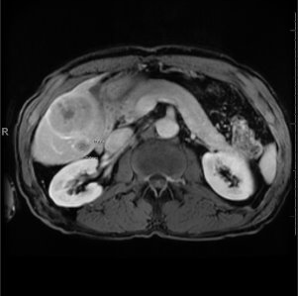
Pre – Procedural Imaging
Pre procedural contrast enhanced axial MRI image showing a 6cm capsule enhancing lesion (arrow) in the inferior right lobe of the liver

Slide 5
Clinical Course
Hepatic resection was attempted, but intraoperative course was complicated by severe adhesions, with bowel injury resulting in right colectomy.
Due to post colectomy bleeding, the patient underwent right colic artery coil embolization.
The patient was discussed at the Hepatobiliary Tumor Board and the decision was to proceed with Conventional TACE + SBRT treatment.

Slide 6
Procedure
The procedure, indication, risks, complications and alternatives were discussed with the patient.
Procedure was performed under general anesthesia.
The right common femoral artery was accessed with a micro puncture set
A 6Fr sheath was placed over an 0.035” Guidewire

Slide 7
Procedure
A 5 Fr RC-2 catheter was then placed into the abdominal aorta and celiac arteriography was performed (fig 1), demonstrating patent splenic, common hepatic, left gastric with replaced left hepatic artery
The target was identified as a hypervascular lesion within the Right hepatic lobe.
Occlusion of the proximal right hepatic artery with distal reconstitution through a tortuous collateral from the middle hepatic artery

Slide 8
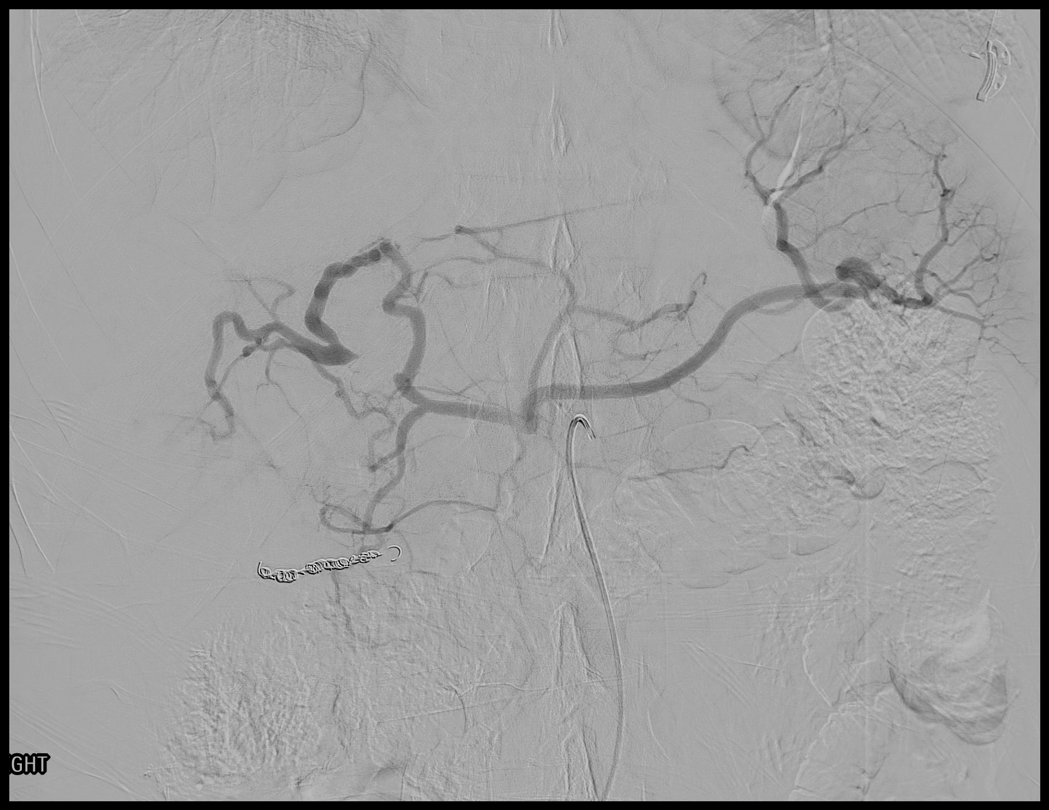
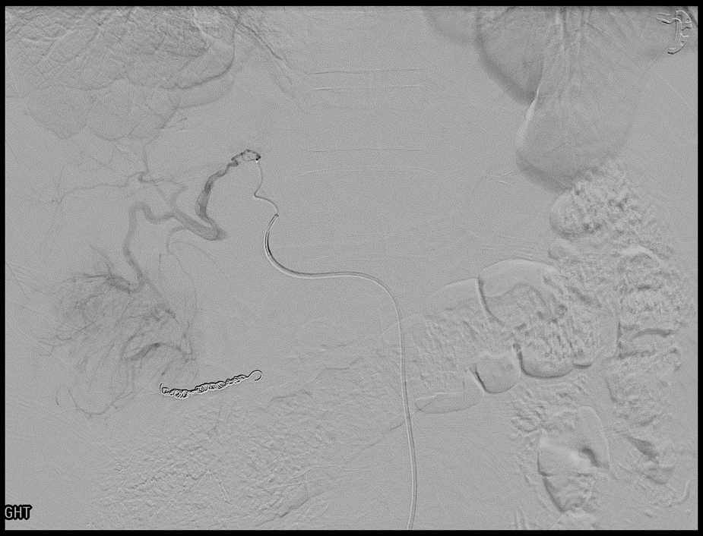
Procedure
Figure 1
Figure 2
Figure 1: Celiac angiogram, arrow in figure shows the absent segment of the right hepatic artery with supply through the collateral vessel ( )
Figure 2: The microcatheter is within the middle hepatic artery, with angiogram showing the collateral supply ( ) to the hypervascular right hepatic lobe tumor ( black arrow)

Slide 9
Procedure
2.4Fr Progreat catheter was inserted through the diagnostic catheter
The microcatheter was navigated through the collateral vessel (fig 2) to access the right hepatic artery. An angiogram illustrated the hypervascular lesion.
The segmental artery was selected and the microcatheter was positioned for chemoembolization (fig 3)
A hypervascular tumor with arteriovenous shunting to the right hepatic vein was seen following subselective angiogram. 1ml of gelfoam slurry was administered, and reduced shunting was confirmed with followup imaging.

Slide 10
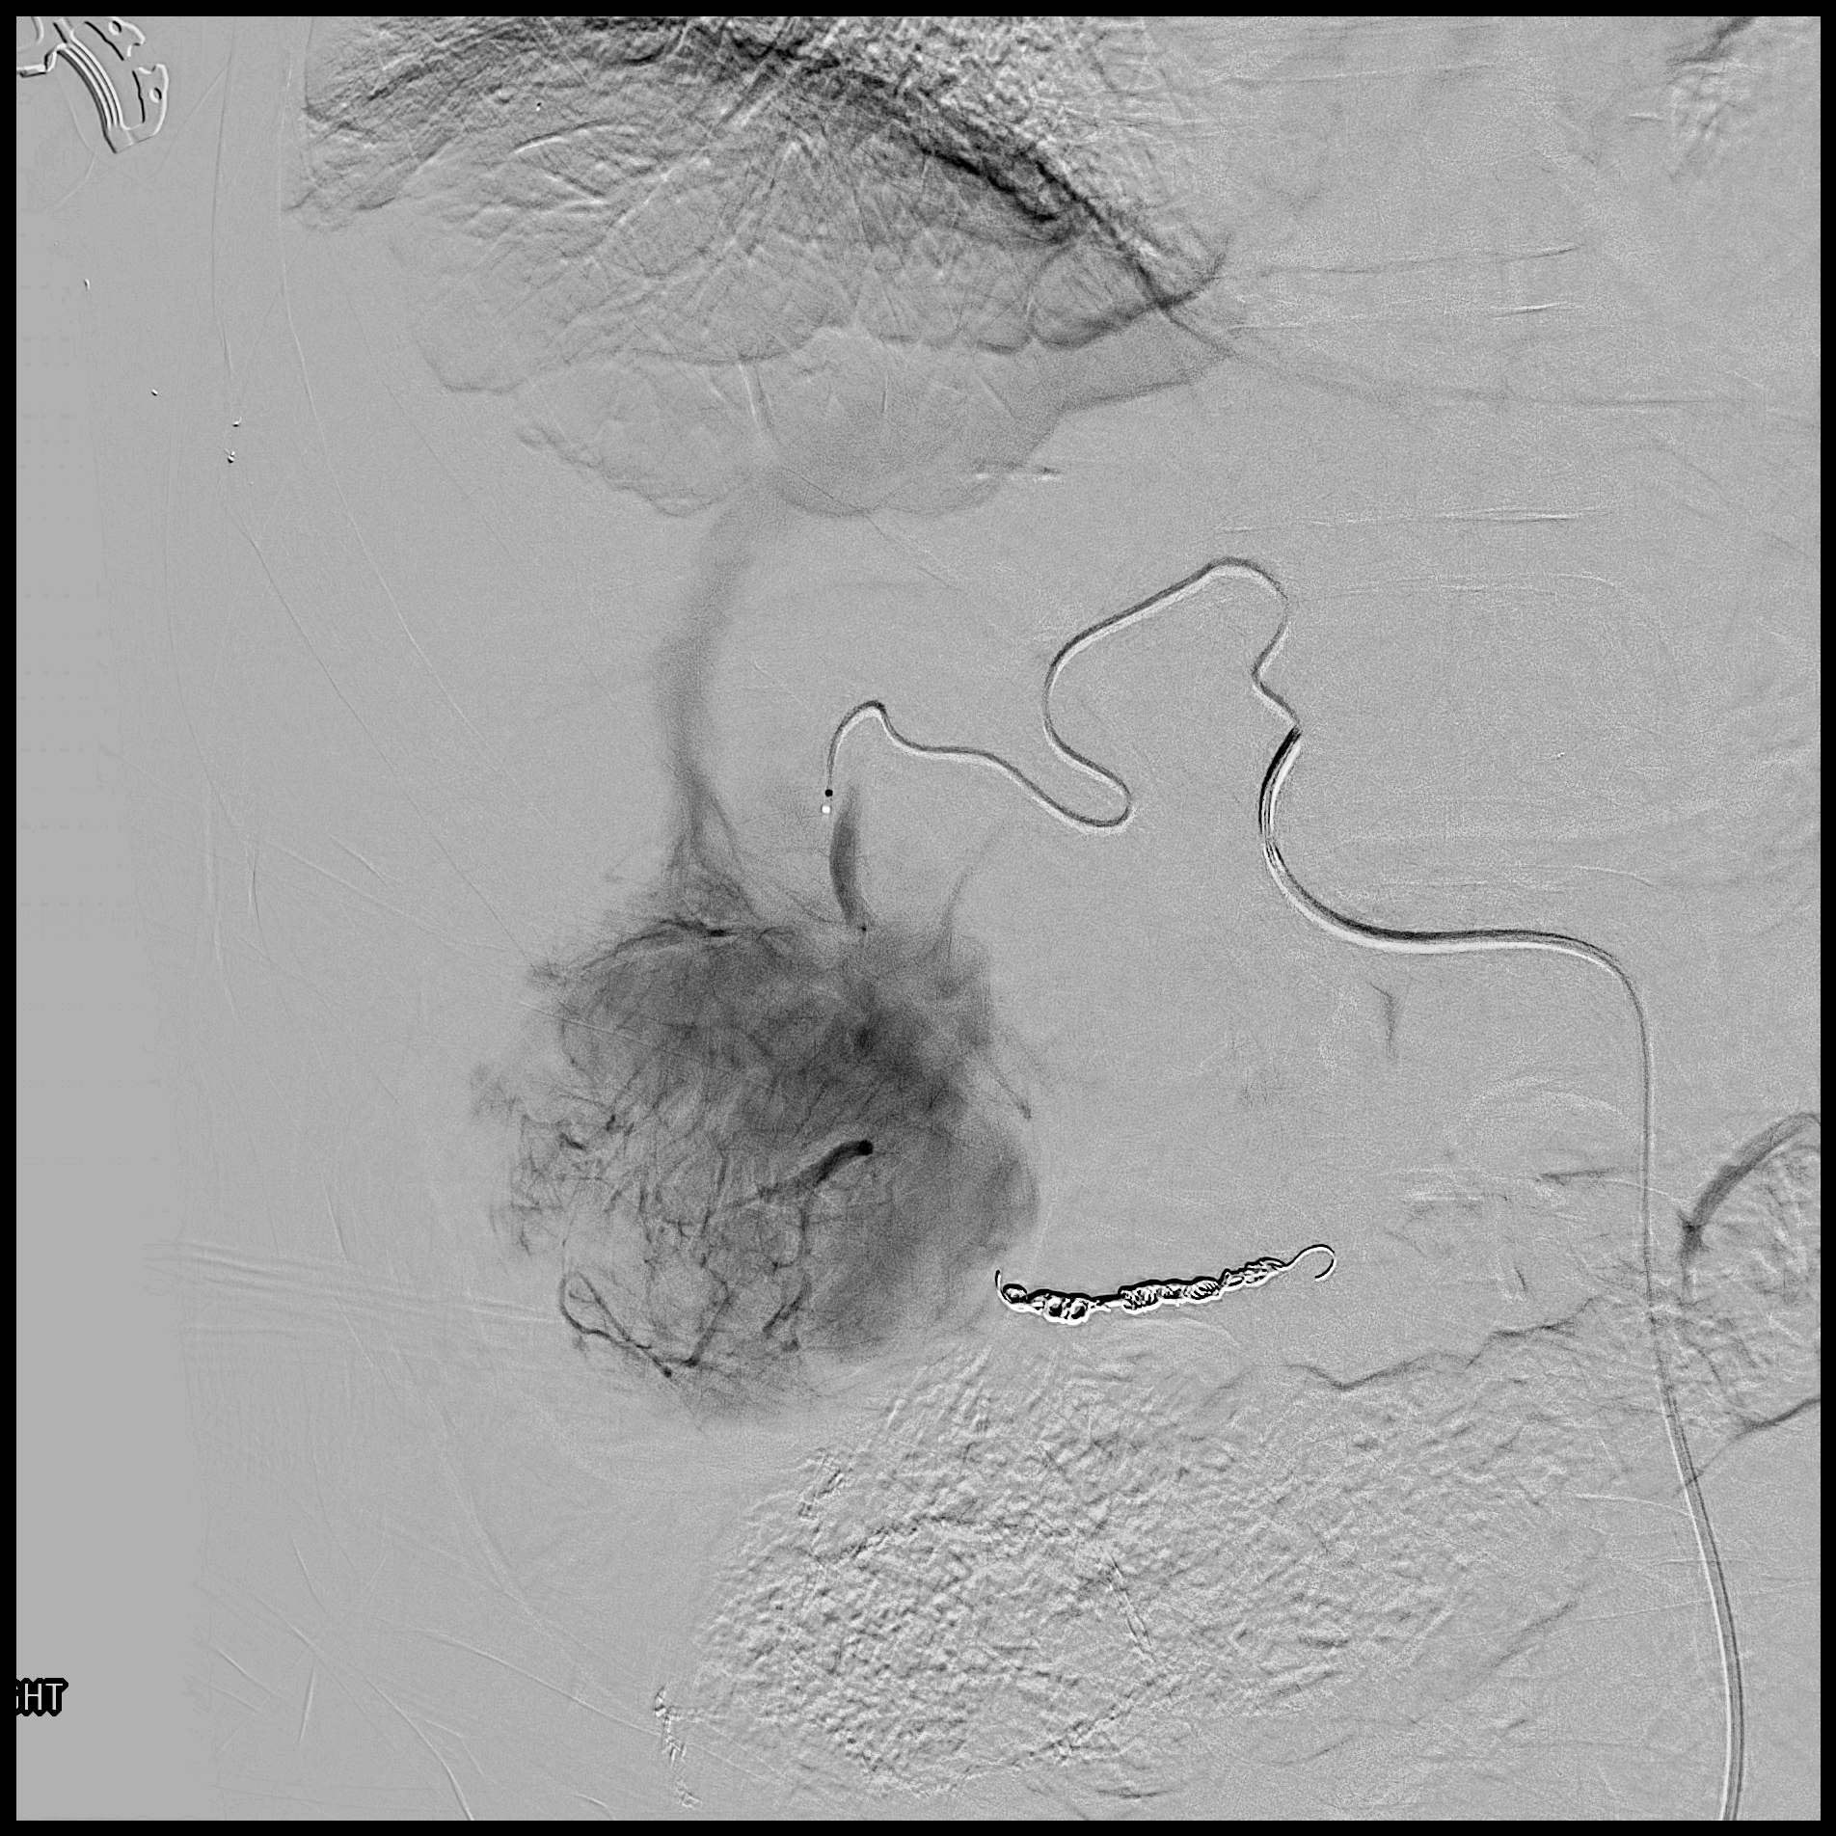
Procedure
Figure 3
Figure 3:The microcatheter is navigated across the collateral into the segmental artery branch of the right hepatic artery supplying the tumor. Arteriogram showed the hypervascular lesion with arteriovenous shunting to the hepatic vein is seen (arrow).

Slide 11
Procedure
Chemoembolization was performed with a mixture of 50mg of Doxorubicin, 3ml of Visipaque and 10ml of lipiodol, followed by small volume of gelfoam slurry (fig 4)
Follow up angiogram demonstrated satisfactory embolization (fig 5).

Slide 12
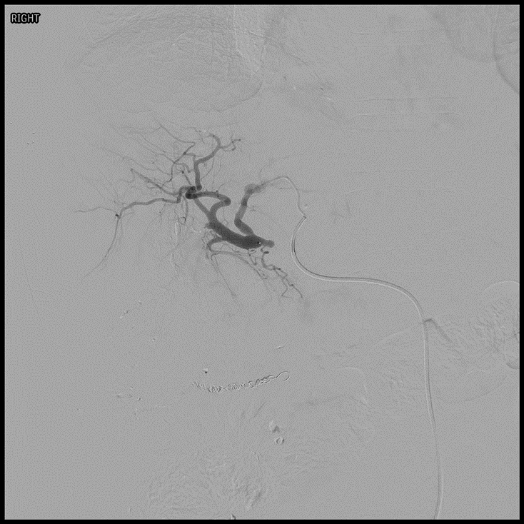
Procedure
Figure 4
Figure 5
Figure 4: Spot flouroscopic image showing adequate lipiodol staining of the targeted tumor
Figure 5: Post-embolization imaging demonstrating successful chemoembolization of the targeted tumor

Slide 13
Post-Procedure
After a short observation, the patient was discharged on Oxycodone and Zofran and scheduled for a 4 week follow up.
MRI at 4 weeks showed a treated inferior right hepatic lobe, with no residual enhancing component compatible with successful TACE.

Slide 14
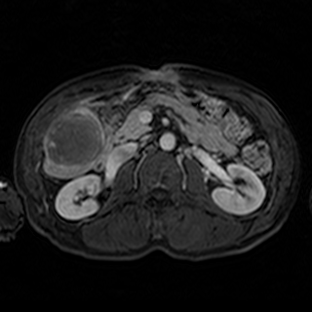
Post Procedural Imaging
Figure 6: Axial contrast enhanced MRI shows a treated lesion (arrow) at 4 weeks post-TACE

Slide 15
Education
Intrahepatic collaterals can be of perivascular, intersegmental, intrasegmental types of vessels. These collateral can be helpful in case of occluded artries.
Hepatocellular carcinomas are highly vascular and angiogenesis plays an important role in tumor growth and invasion.
TACE is the recommended treatment according to BCLC guidelines for multinodular tumors, Child-Pugh class A/B, ECOG PS <= 2
Variant anatomy can be a challenge while approaching intra-arterially. A careful and meticulous approach is needed to embolize feeder vessels to prevent recurrence of the tumor.

Slide 16
References
Reig M, Forner A, Rimola J, Ferrer-Fàbrega J, Burrel M, Garcia-Criado Á, Kelley RK, Galle PR, Mazzaferro V, Salem R, Sangro B, Singal AG, Vogel A, Fuster J, Ayuso C, Bruix J. BCLC strategy for prognosis prediction and treatment recommendation: The 2022 update. J Hepatol. 2022 Mar;76(3):681-693. doi: 10.1016/j.jhep.2021.11.018. Epub 2021 Nov 19. PMID: 34801630; PMCID: PMC8866082.
Yao C, Wu S, Kong J, Sun Y, Bai Y, Zhu R, Li Z, Sun W, Zheng L. Angiogenesis in hepatocellular carcinoma: mechanisms and anti-angiogenic therapies. Cancer Biol Med. 2023 Jan 12;20(1):25–43. doi: 10.20892/j.issn.2095-3941.2022.0449. PMID: 36647777; PMCID: PMC9843448.
Song SY, Chung JW, Kwon JW, Joh JH, Shin SJ, Kim HB, Park JH. Collateral pathways in patients with celiac axis stenosis: angiographic-spiral CT correlation. Radiographics. 2002 Jul-Aug;22(4):881-93. doi: 10.1148/radiographics.22.4.g02jl13881. PMID: 12110717.

